Slide 1
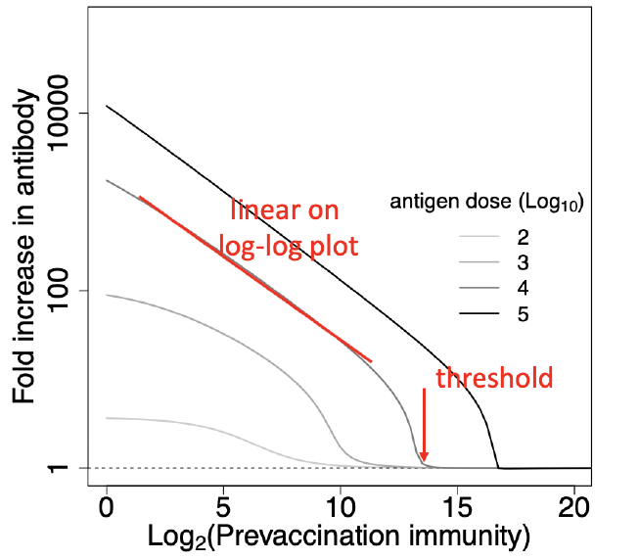
How does pre-existing immunity interact with other factors to impact influenza vaccine responses? Zane Billings, Andreas Handel
Fig from Zarnitsyna VI et al, PLoS Pathog, 2016.
In general, individuals with higher preexisting immunity have weaker vaccine responses.
Our collaborators used a mechanistic host vaccine response model to make quantitative predictions about this relationship. (Fig 1.)
Our goals with CIVIC human cohort data:
Check these predictions.
Examine effect modification by other host factors, e.g. age.
Examine cross-protective vaccine responses.
Fig 1. Mechanistic model predictions. We expect linear log-log plots most of the time with effect modification by dose.

Slide 2
How does pre-existing immunity interact with other factors to impact influenza vaccine responses? Zane Billings, Andreas Handel
Fold increase in HAI titer
Log2 preexisting immunity before vaccination (HAI titer)

